Slide 1

YAMUNA - The Personal Voice Assistant
Automate tasks on your PC with just voice commands! Yamuna simplifies how you interact with your computer. Control applications, settings, and more using your voice. Experience a new level of personal productivity and accessibility.

Slide 2
Introduction
YAMUNA is a smart voice assistant designed to control your PC with voice commands. It simplifies tasks like opening apps and controlling system settings.
Get real-time updates with just your voice. YAMUNA is your personal assistant, ready to respond to your needs. Simplify your digital life today.

Slide 3
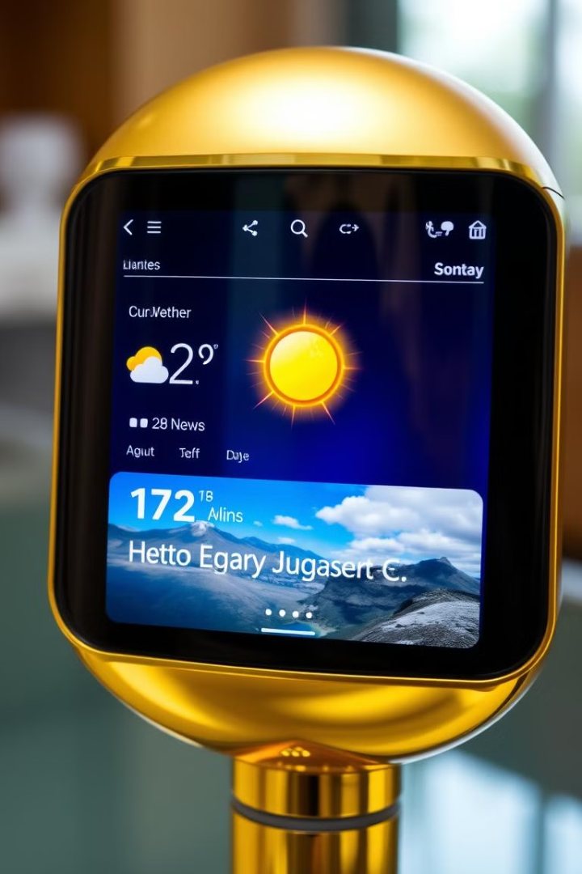
Features & Capabilities
1
Application Control
Open applications with just your voice.
2
System Control
Control volume & brightness using voice commands.
3
Multimedia Playback
Play YouTube videos effortlessly.
4
Information Updates
Get weather & news updates instantly.

Slide 4

Technical Stack
Speech Recognition
Advanced algorithms for accurate voice detection.
pyttsx3
Text-to-Speech conversion for voice responses.
Gemini 2.0 Flash AI API
Enhanced AI for intelligent assistance.
OS & Time Libraries
Core libraries for system operations.

Slide 5





Workflow Overview
Detect Wake-up Word
YAMUNA listens for its name.
Process the Voice Command
The command is analyzed and understood.
Execute the Command
The action is performed on your PC.
Await Next Command
YAMUNA is ready for further instructions.

Slide 6
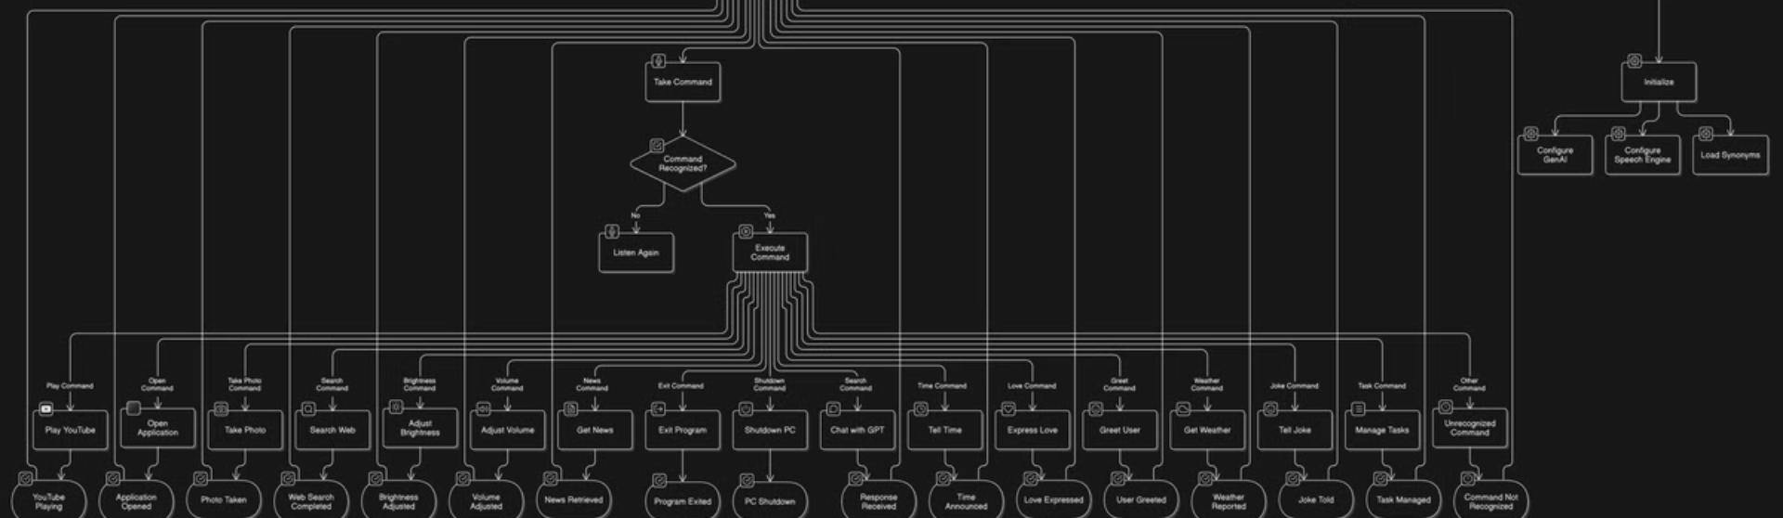
Flowchart
Visual representation of YAMUNA's workflow. The flowchart shows step-by-step the processes that happen to execute your commands.

Slide 7




Command Categories
App Control
System Control
Launch and manage your applications.
1
2
Adjust volume, brightness, and other settings.
User Assistance
Information Retrieval
4
3
Set reminders and manage to-do lists.
Get news, weather, and other updates.

Slide 8

Challenges & Solutions
Speech Recognition
1
Optimization for accuracy and speed.
2
Voice Adjustments
Fine-tuning speed and tone for clarity.
API Integration
3
Ensuring robust and reliable performance.
4
Voice Animation
Adding an engaging visual overlay.

Slide 9

Future Improvements
GUI
User-friendly interface for permissions and settings.
Security
Enhanced protection and firewall integration.
OS Optimization
Tailored for specific operating systems.
Contextual Responses
Intelligent and relevant answers.

Slide 10

Conclusion & Demo
YAMUNA streamlines PC interactions. It makes technology more accessible and user-friendly. Future updates will bring enhanced security and more features.
See YAMUNA in action with a live demonstration. Witness the power of voice-controlled computing. Experience the future of personal productivity.

